Slide 1
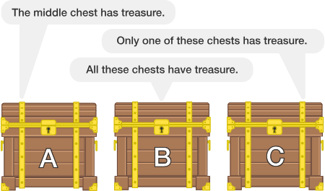
Each chest has a message on it, but all the messages are lying.

Slide 2
While changing a tyre, a motorist accidentally dropped all four wheel nuts into the sewer grate. He tried everything to retrieve them, but — to no avail. The man was beginning to suspect that he would have to spend many hours by the roadside, when a passing kid suddenly helped him solve the problem. Acting on the kid’s advice, he successfully fitted a new tyre and drove to the nearest service station without accidents.
What was the advice that the child had given the motorist?

Slide 3
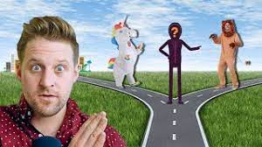
A man is caught on the king's property. He is brought before the king to be punished. The king says, "You must give me a statement. If it is true, you will be killed by lions. If it is false, you will be killed by trampling of wild buffalo. If I can’t figure it out, I’ll have to let you go.” Sure enough, the man was released. What was the man's statement?

Slide 4
"I will be killed by trampling of wild buffalo.” This stumped the king because if it’s true, he’ll be killed by lions, which would render the statement not true. If it’s a lie, he’d be killed by wild buffalo, which would make it a truth. Since the king had no solution, he had to let the man go.

Slide 5
